Slide 1

DSAIL Camera Trap
Realization and Deployment
Jason KABI
Centre for Data Science and Artificial Intelligence (DSAIL)
Dedan Kimathi University of Technology

Slide 2
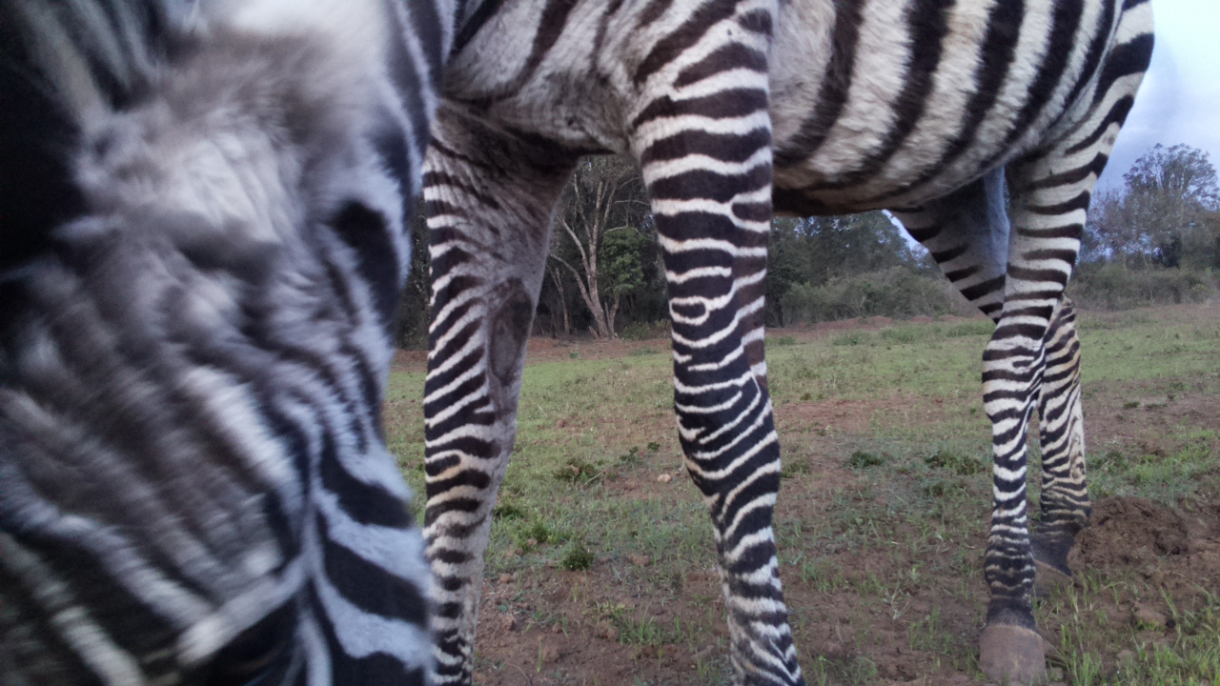
Realization
Task : Wildlife image data acquisition

Slide 3
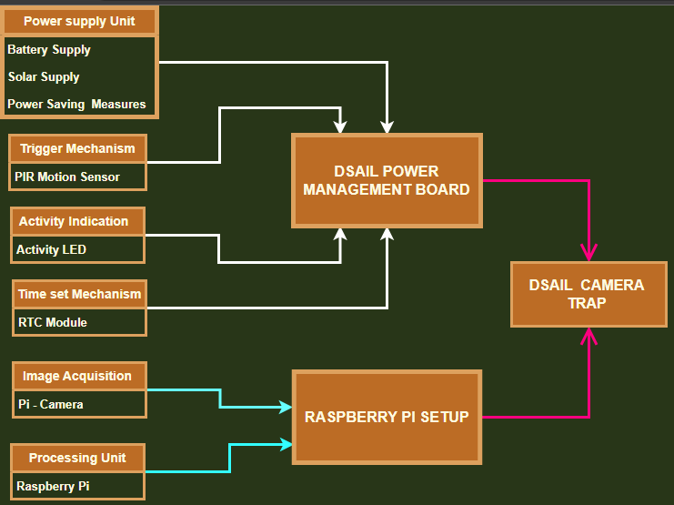
Hardware Components Needed

Slide 4
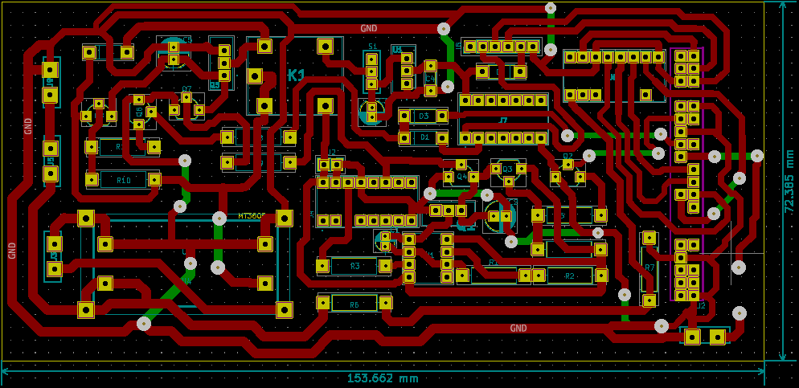
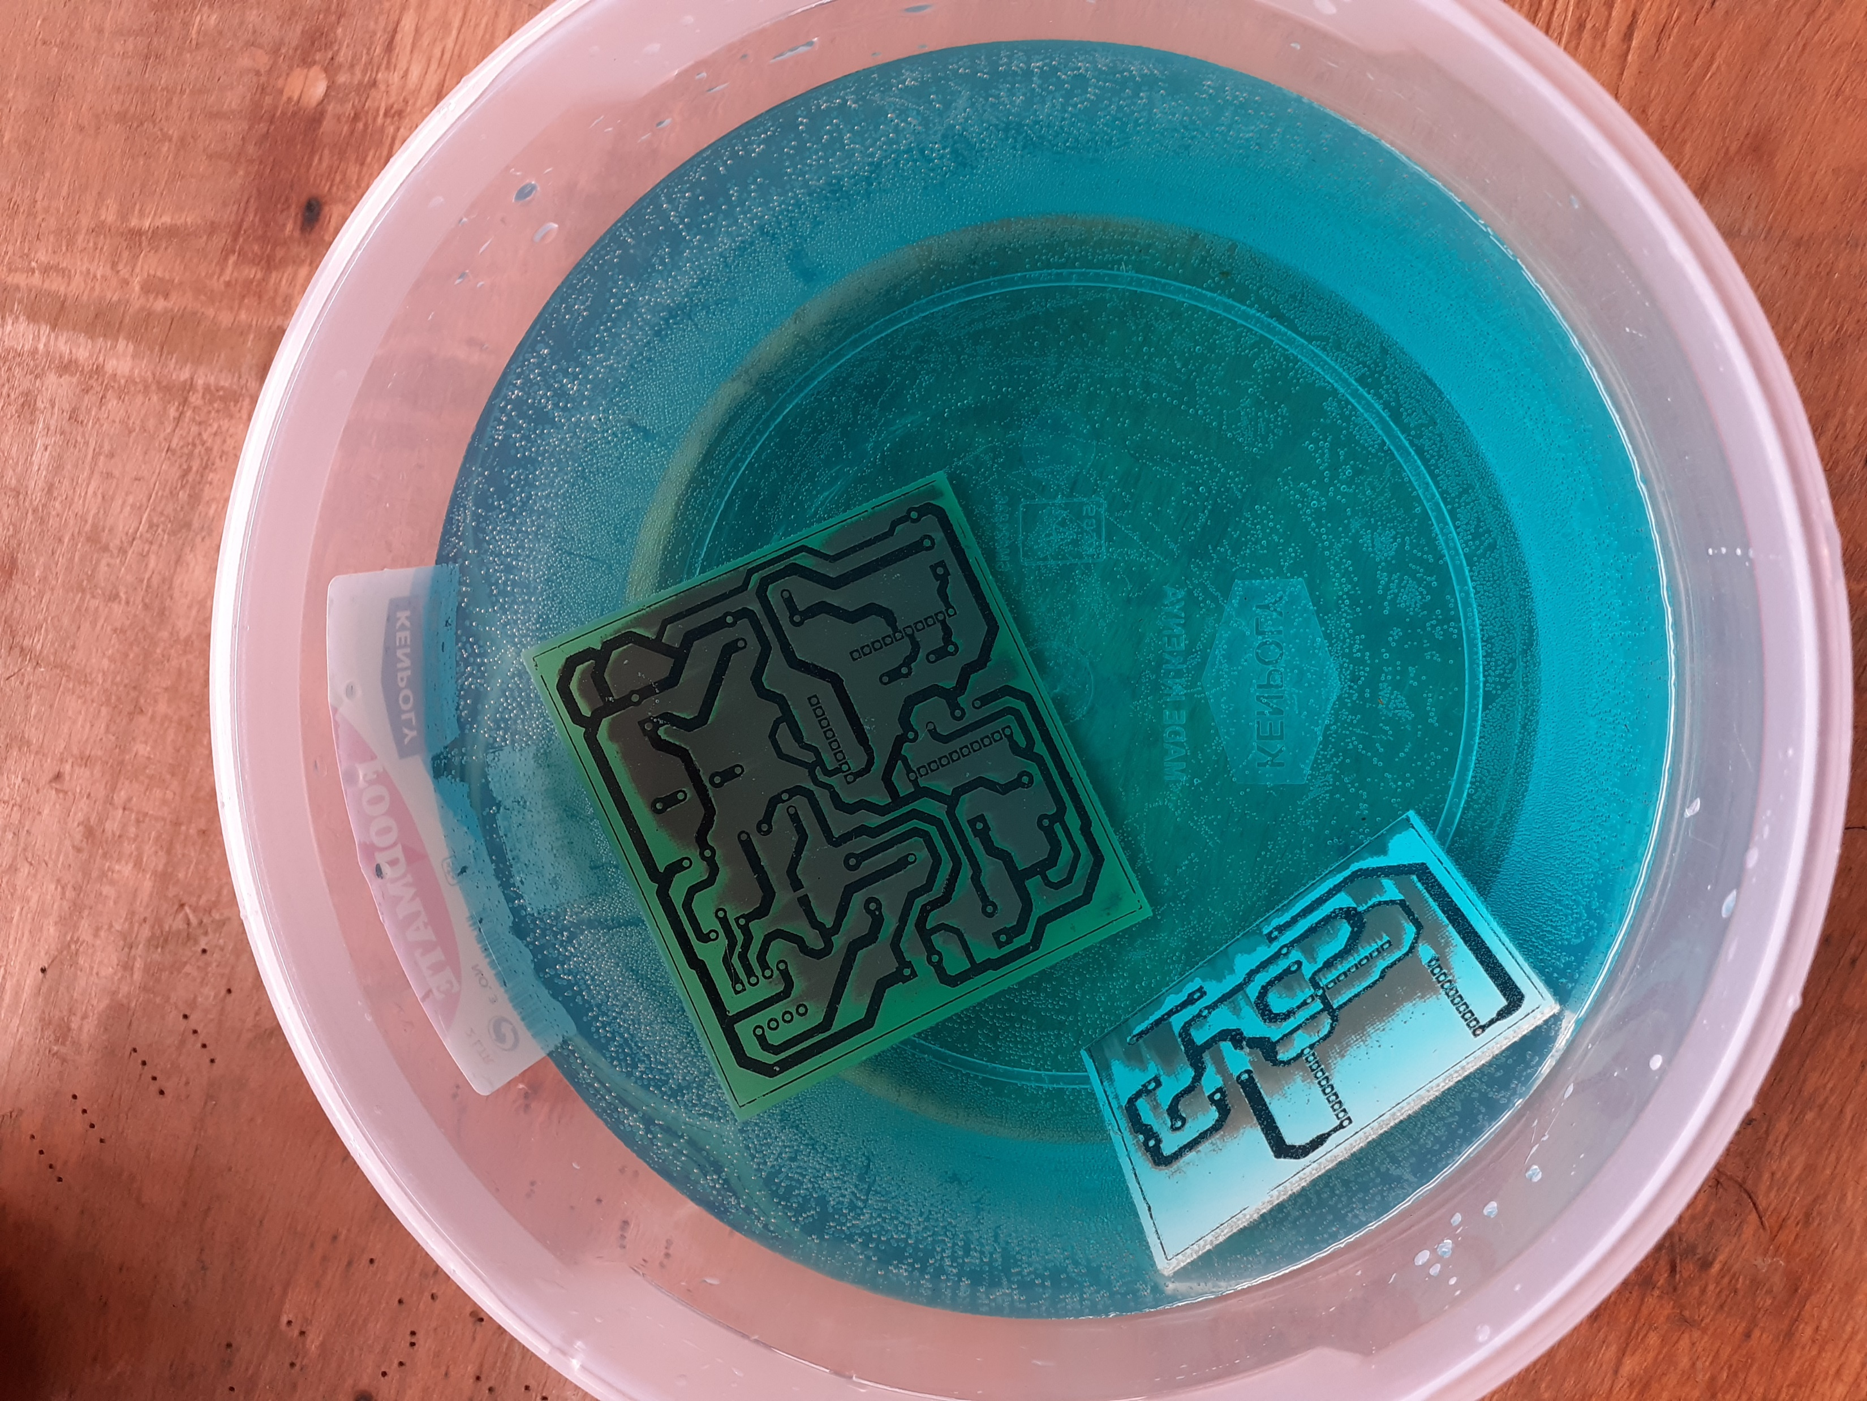
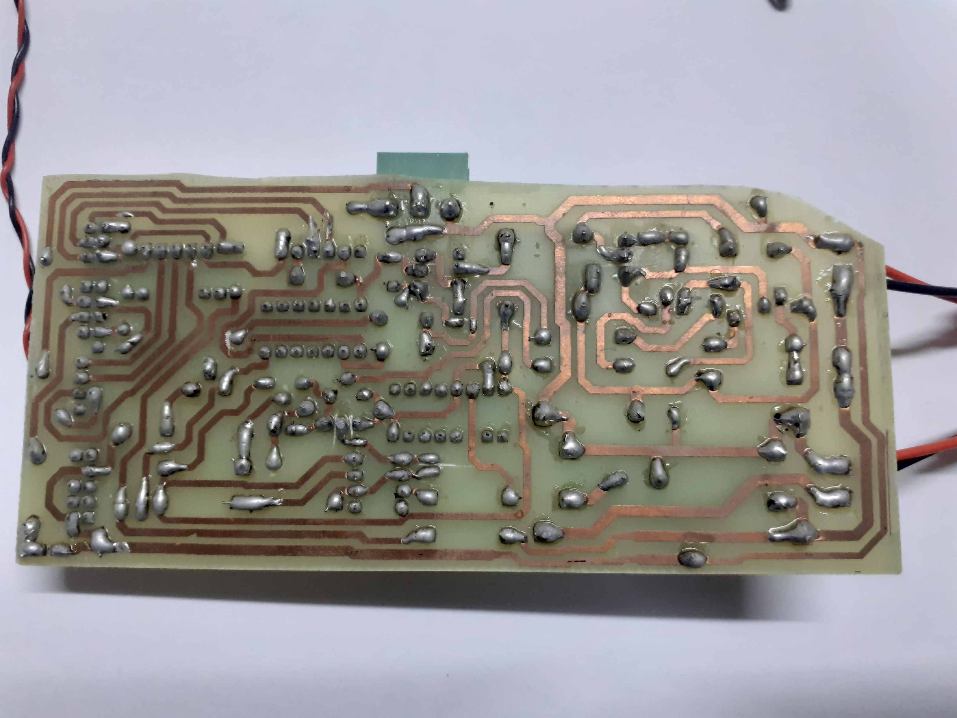
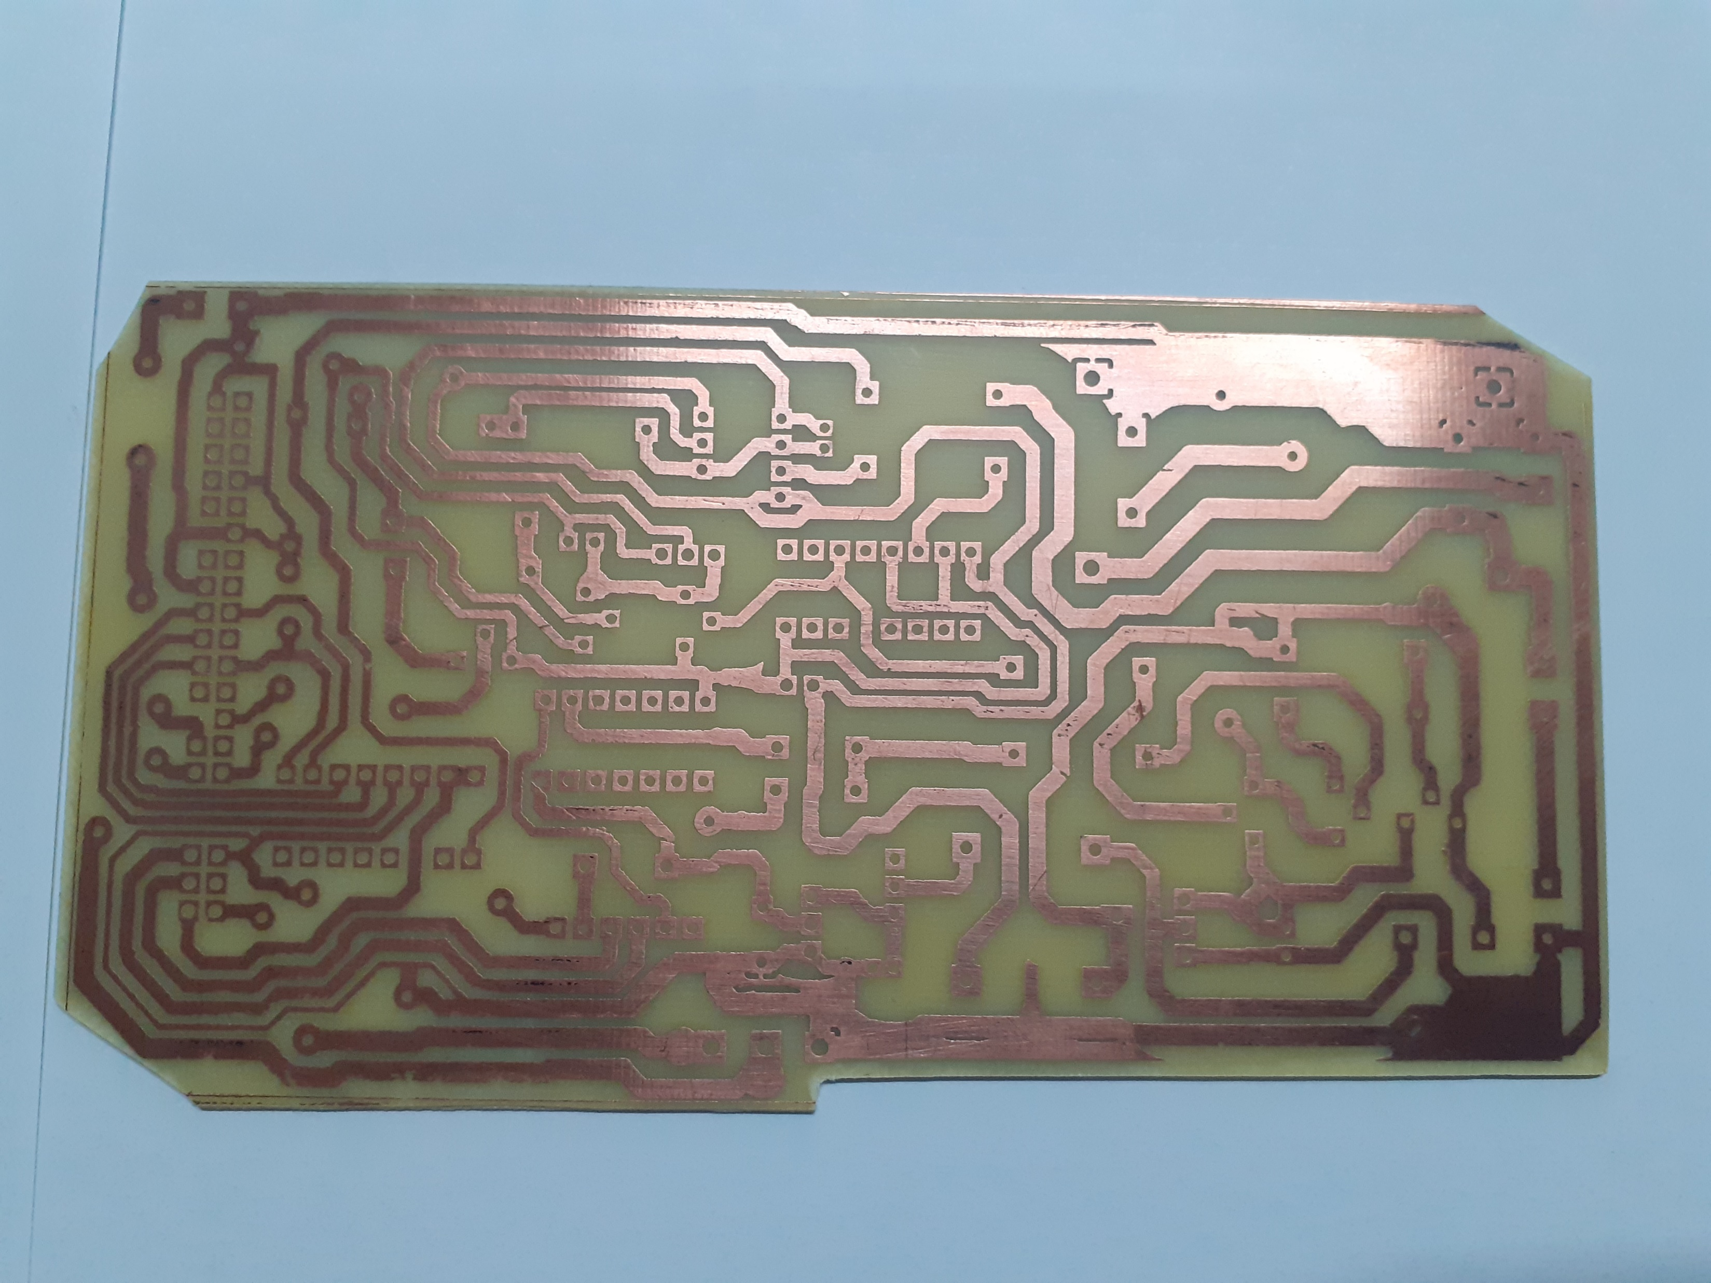
DSAIL Power Management Board – development steps
CAD Design
Etching Process
Final Product
Etched power board

Slide 5
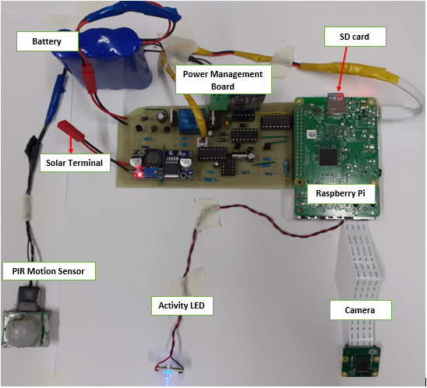
Cont’d – Full Setup
Full camera trap setup consisting of the sections mentioned

Slide 6
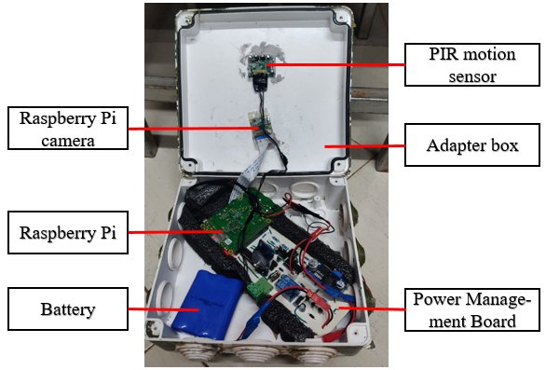
Deployment-ready Setup.
The setup shown on the previous slide was fitted into a plastic enclosure to make it ready for deployment.

Slide 7
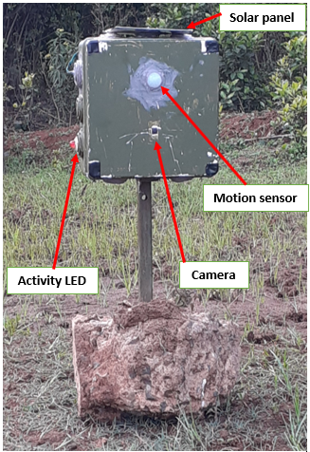
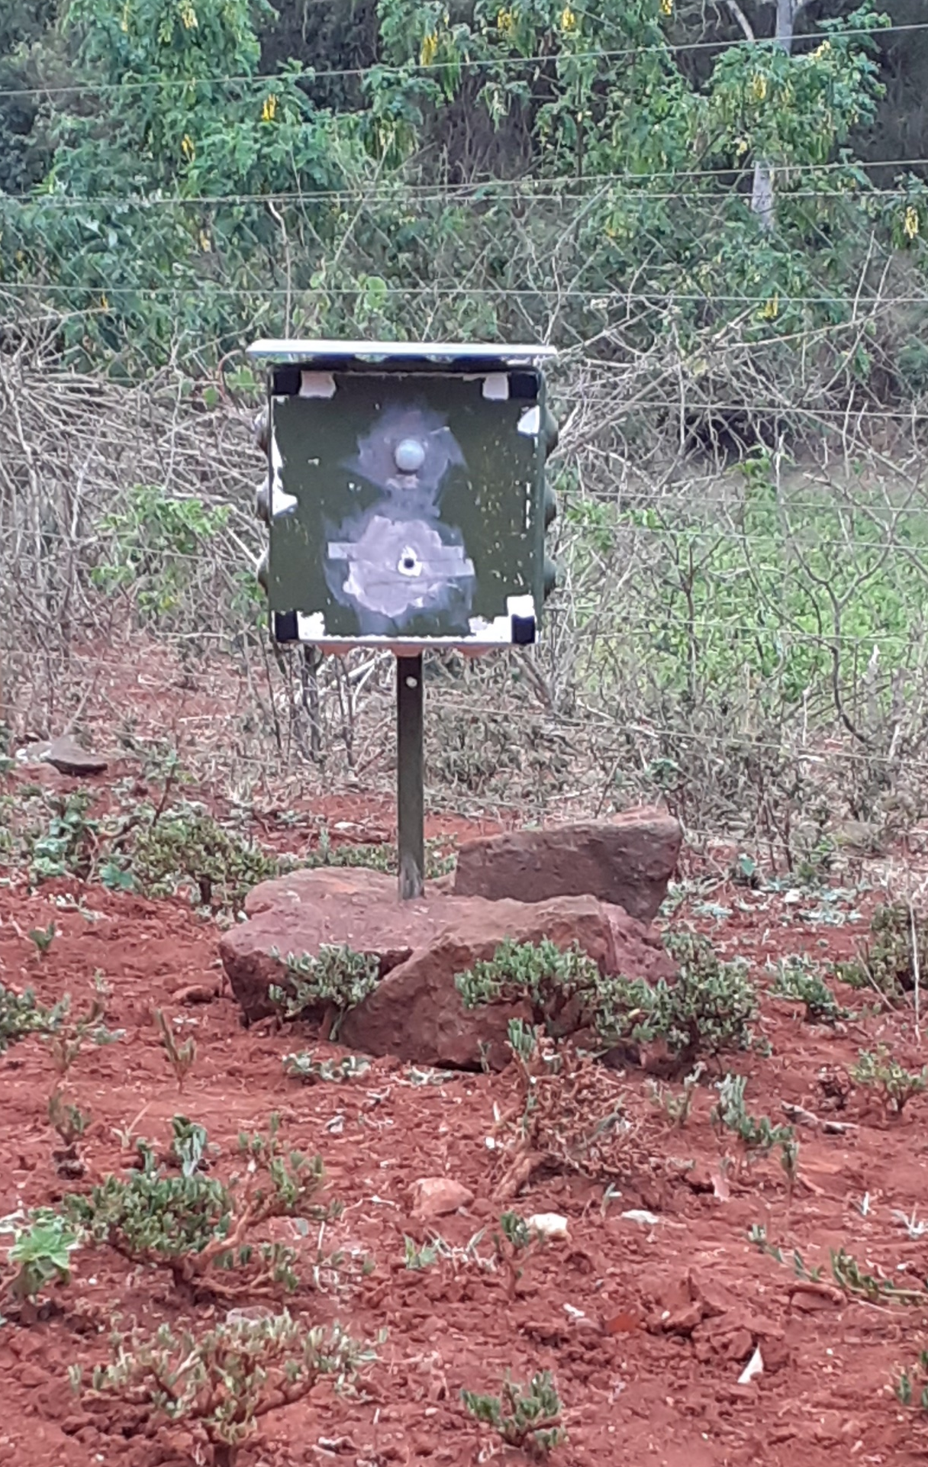
Deployment
Setups in the field. Three deployed camera traps.

Slide 8
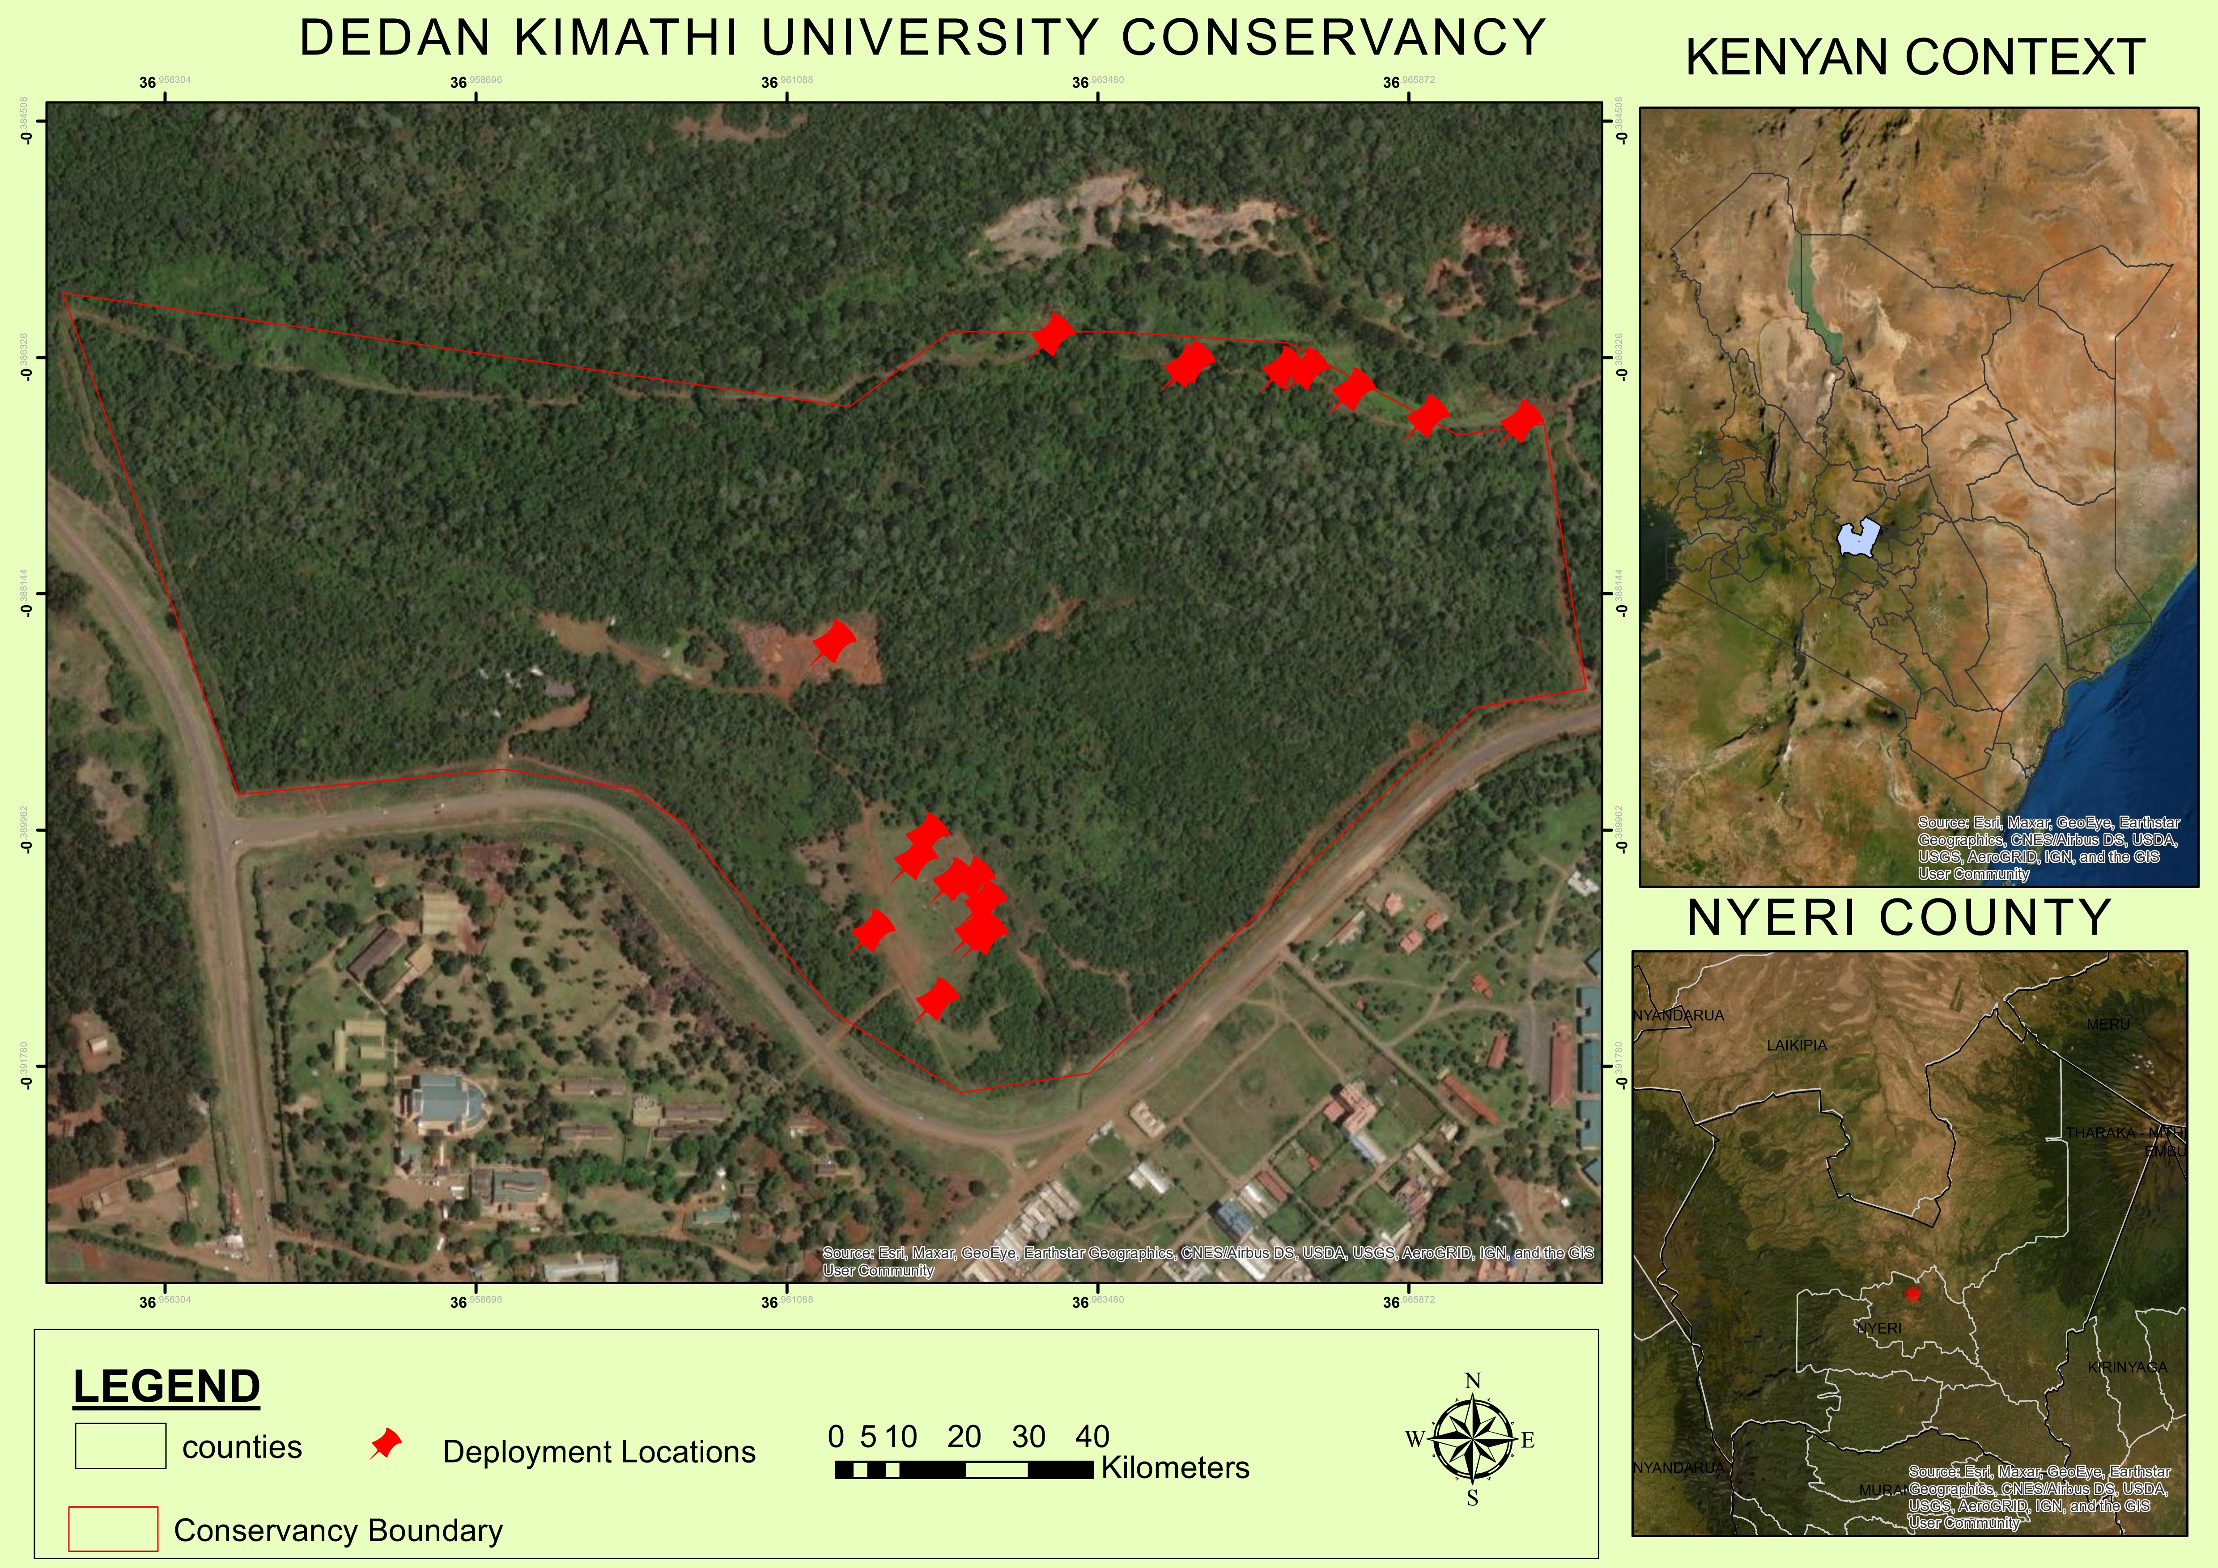
Deployment Location

Slide 9
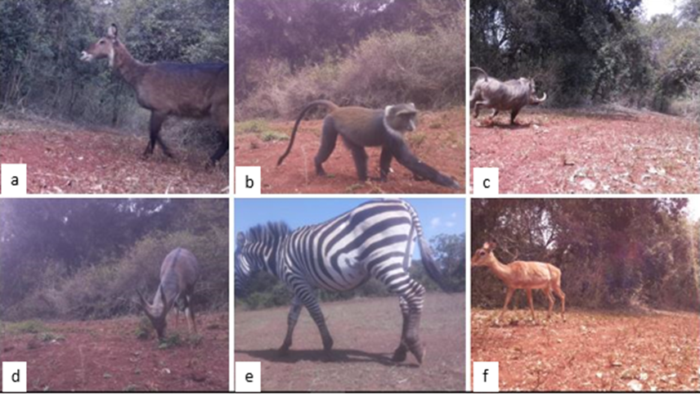
DSAIL Porini dataset
From the 4 camera traps deployed we have about 8524 annotated images of animals. The dataset has 6 categories; impalas, warthogs, zebras, monkeys, waterbucks, bushbucks, tortoise.
Deployed from JUNE 2021 to December 2021 and we are back in the field.
Annotation was done manually with help from the ranger at the conservancy.

Slide 10
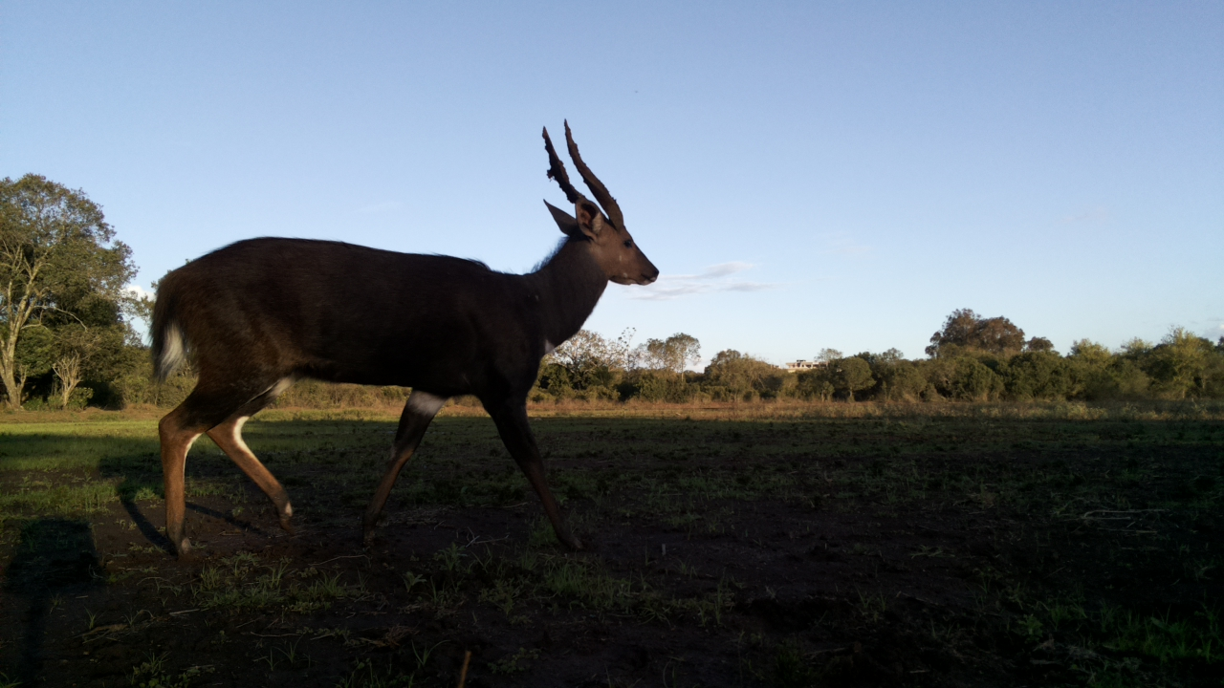
Other shots.. Bush buck

Slide 11
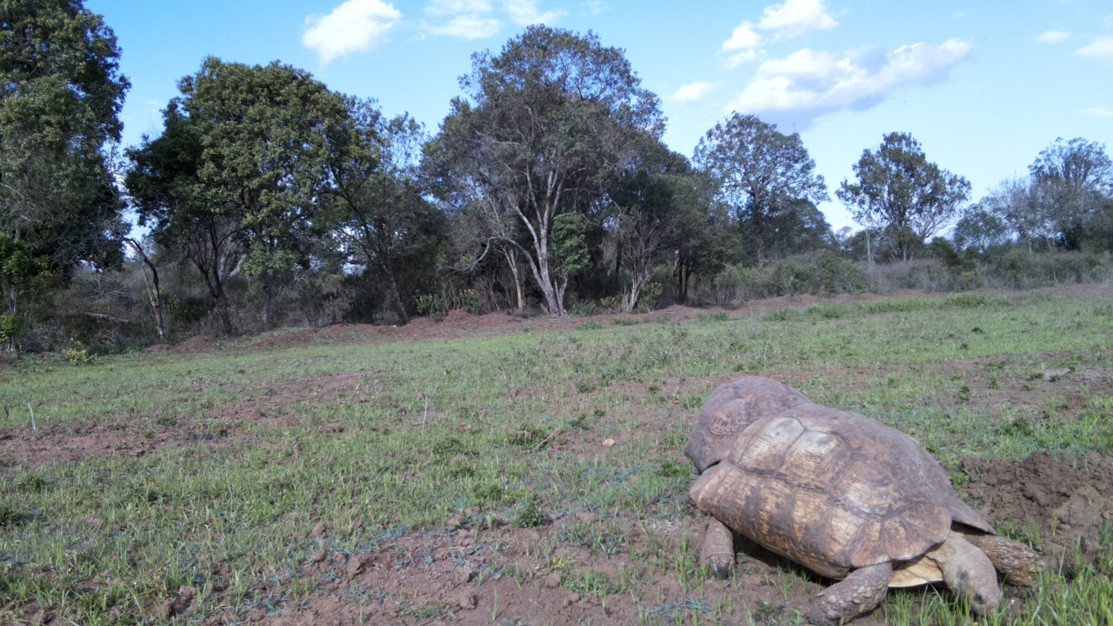
Other shots.. Tortoise

Slide 12
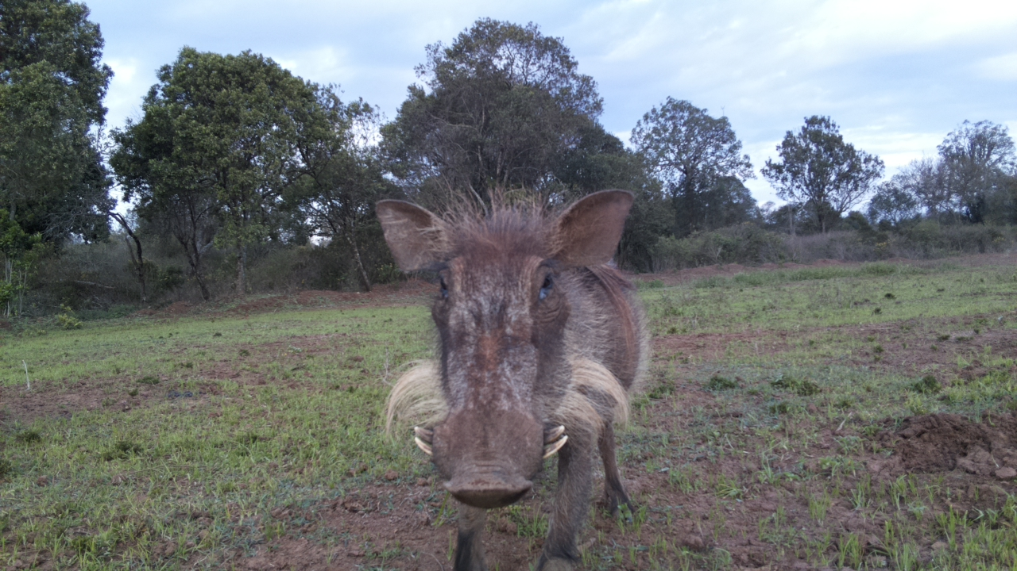
Other shots… Warthog

Slide 13
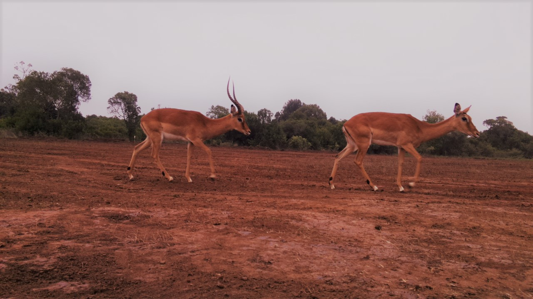
Other shots… Impala

Slide 14
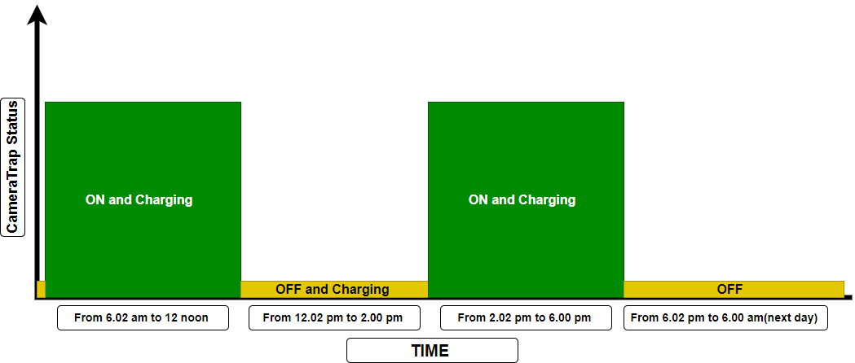
Camera Trap Operation Window
We noted that most of the image containing animals were being captured in the morning hours and in the evening hours, hence we decided to come up with the operation routine shown below.
Operation window

Slide 15
Deployment-Location Choice Influences
Water points in the conservancy and the paths leading to the water points
Grazing fields to capture some grazers
Supplement supply points
Paths leading to sleeping points
Deployment Challenges.
Lens Flare
Very few cases of vandalism by animals
False triggers – less than 30 percent of images achieved have animals in them.

Slide 16
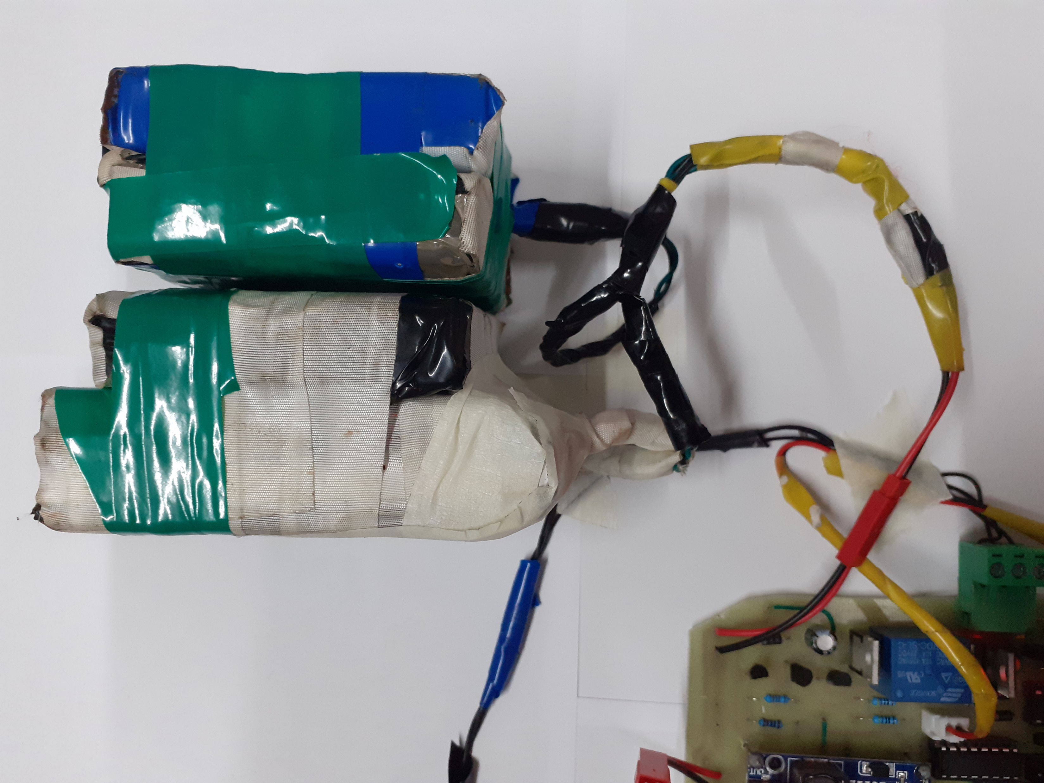
Power Analysis
Power Supply Specifics
60,000mAh lithium ion battery (big battery)
12V, 450mA solar panel (little output solar panel)
Operation window: 7 days max
Challenge: Mismatch between the battery and the solar panel.

Slide 17
Monitoring Of Power Analysis Data- Battery Voltage
Apart from collecting image data, we also collect the battery voltage data during a deployment window.
This data helps us in knowing:
How many days the camera trap was operational
Power consumption
Evidence of charging
Is the on and off routine being followed.
On slide 16 is a plot showing the battery voltage trend over one of the deployment window.
Battery voltage sampling interval – 5 minutes.

Slide 18
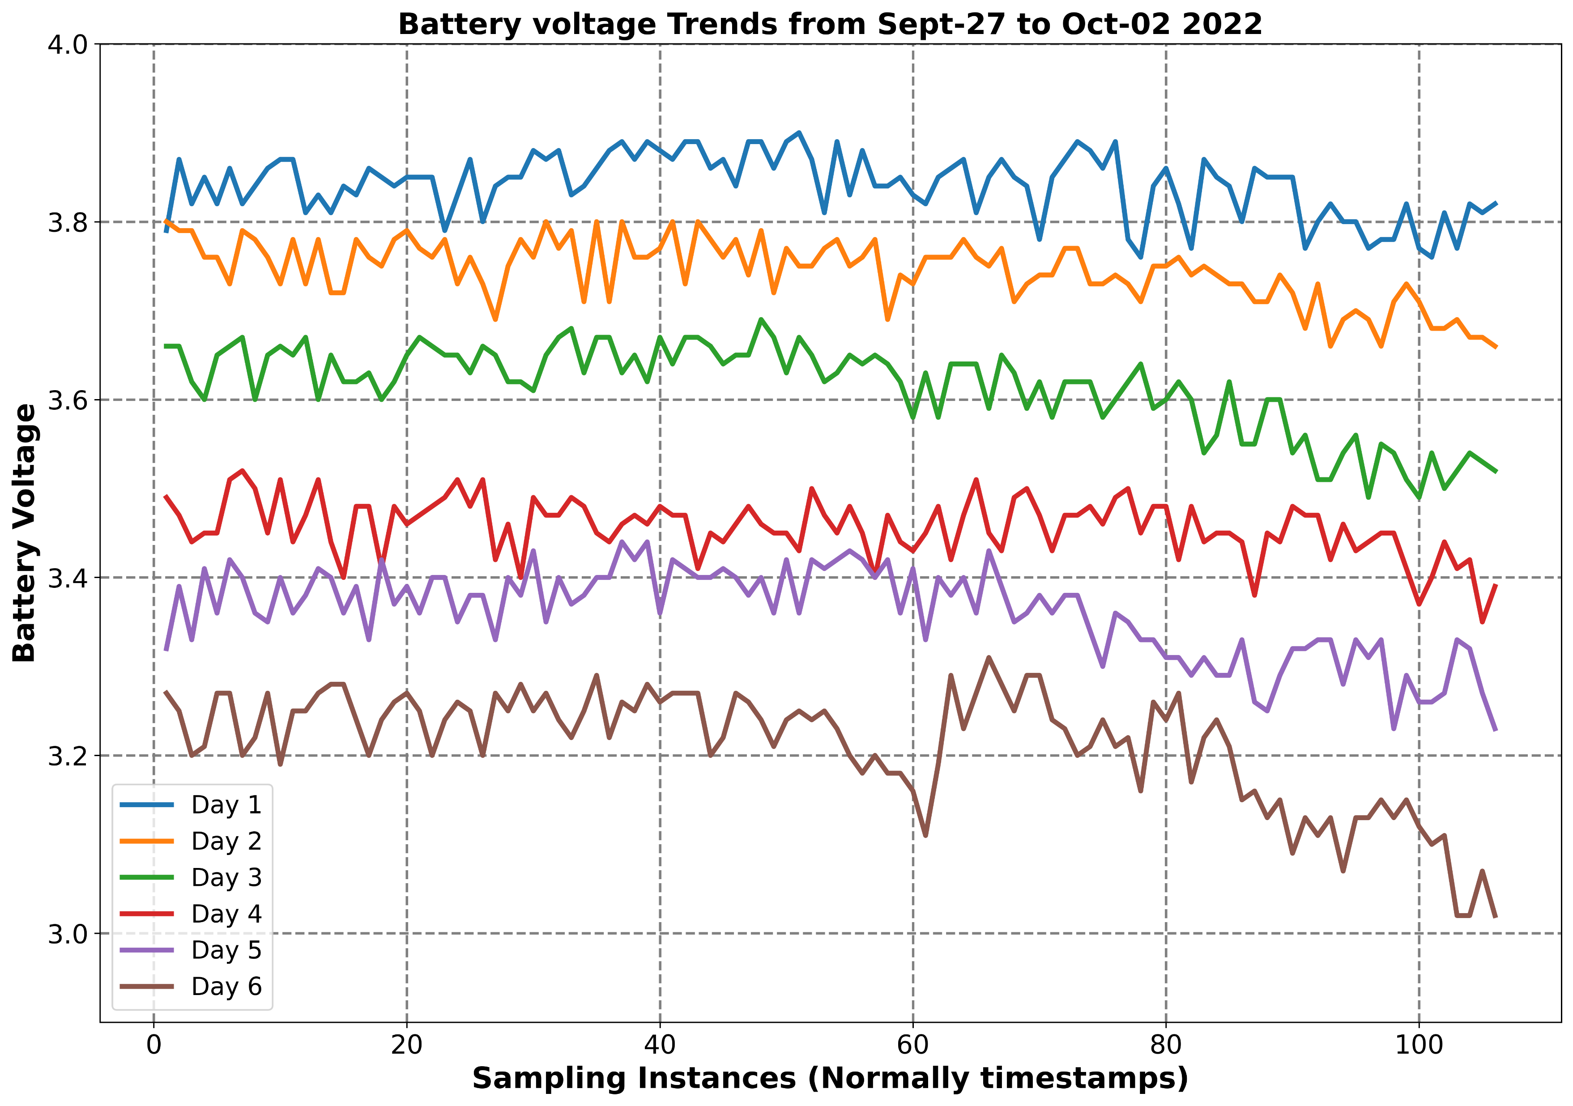
Battery Voltage Trends

Slide 19
Design Improvements
Listed are some of the design improvements that will help us to prolong the operating time/deployment window.
Large battery pack
Matching the large battery pack with a high output and more efficient solar panel. But the size of the solar panel has to be considered.
Alternative hardware: we have developed and deployed an Open-MV based camera trap.
Reducing the number of false triggers that consume a lot of power: we are looking into other trigger mechanisms.
Lower power requirement Raspberry pi for the current design: we are currently working with the raspberry pi zero.

Slide 20
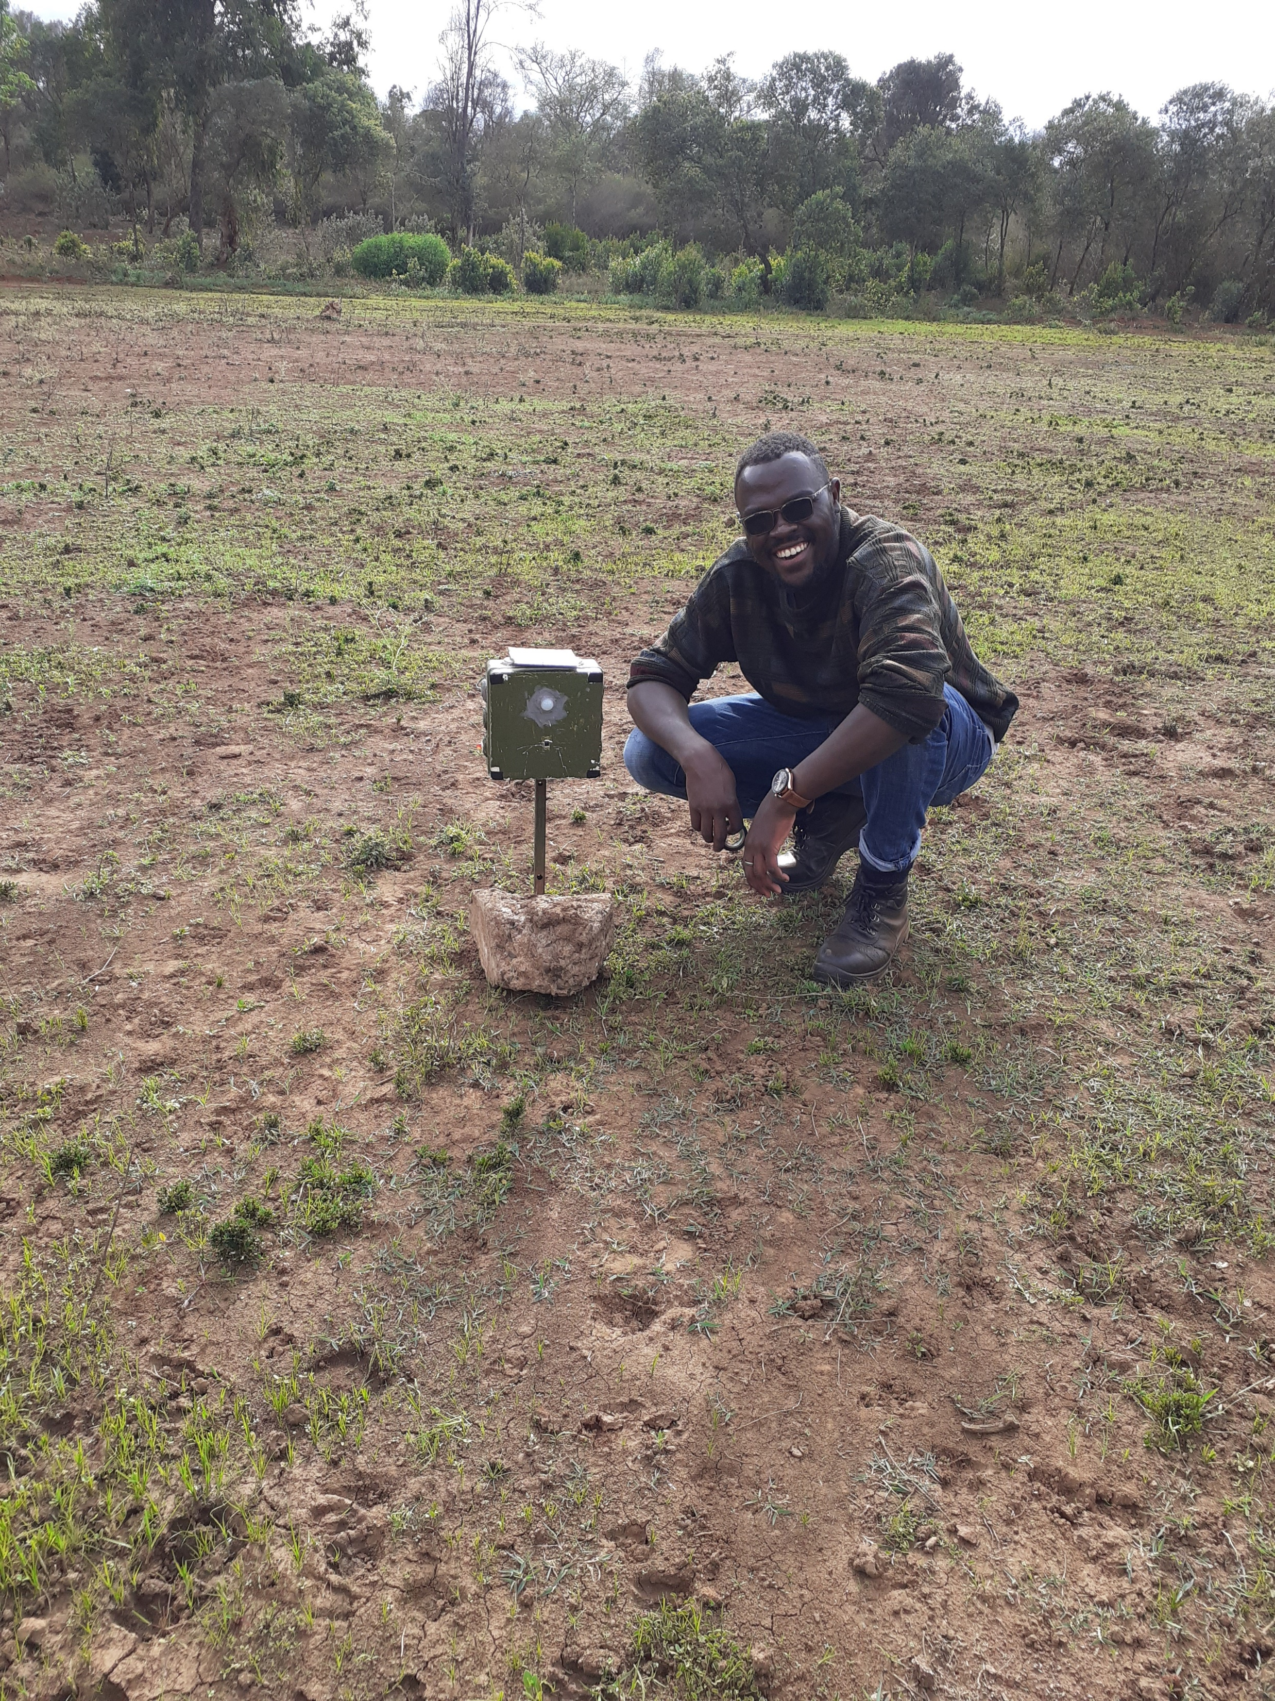
END
dekut-dsail.github.io
Web: kabi23.github.io
Email: jason.kabi@dkut.ac.ke
LinkedIn: Jason Kabi

Slide 21
Up Next
Machine Learning analysis involving the
DSAIL Porini Dataset
By
Yuri and Lorna

